Slide 1



Slide 2







BEYOND CLICKS AND KEYS:
EXPLORING VOICE ASSISTANTS
ON THE DESKTOP
BY : SANJIL K C (20BCE1855)
GUIDED BY : Dr. PRASAD M

Slide 3
01
Introduction
02
Proposed
System
03
Implementation
04
Conclusion
And
Future Work
CONTENTS

Slide 4

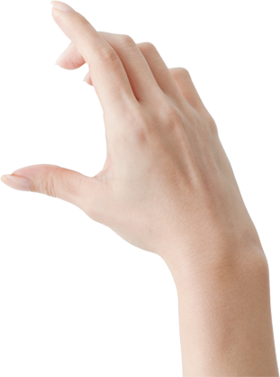
01
Introduction
02
Proposed System
03
Implementation
And
Results
04
Conclusion
And
Future Work
CONTENTS

Slide 5
1.1 Introduction
Alfred is a voice-activated desktop assistant intended to give people a quick and easy method to communicate with computers. Alfred's system architecture prioritizes speech processing and detection above everything else. This is because voice processing and detection translate spoken user commands into text that the system can comprehend and read. Alfred recognizes speech using Google's Speech-to-Text API, which is included into the Python SpeechRecognition module. Because of its real-time speech translation and multilingual capabilities, this API is perfect for voice assistants like Alfred.
The user speaks an instruction or question into the microphone to start the voice recognition process with Alfred. The SpeechRecognition library then records and processes the audio signal before sending the audio data to the Google Speech-to-Text API for transcription. The system analyzes the transcribed text when it is received from the API in order to extract pertinent information and ascertain the user's purpose. After that, the system may carry out the required action, which could be launching an application, conducting an online search, or offering details on a certain subject. Alfred is a useful and approachable tool for users of various backgrounds and skill levels due to its intuitive design and capacity to comprehend natural language.

Slide 6
1.2 Problem Statement
Inaccessibility to those who have trouble using typical desktop interfaces or with impairments.
Difficulty using a desktop computer to manage several things at once.
Laborious and ineffective manual search and command procedures.
Voice-activated desktop assistants with natural language processing and precise speech recognition are hard to come by.

Slide 7
1.3 Research Objective
To create a voice-activated desktop assistant that can identify and react to orders from users with accuracy.
To improve the assistant's capability by giving it the ability to do a variety of things, such starting apps, doing online searches, and giving information.
To include the voice-to-Text API from Google for effective voice processing and recognition.
To assess the voice-activated desktop assistant's functionality and efficacy through user testing and feedback.
To provide an intuitive user interface that facilitates simple communication between the user and the helper.

Slide 8
01
Introduction
02
Proposed System
03
Implementation
And Results
04
Conclusion and
Future Work
CONTENTS

Slide 9
2.1 Proposed System Introduction
The proposed system is a versatile voice assistant designed to simplify daily tasks and enhance user convenience through voice-activated commands.
Users can seamlessly interact with the system to access information, perform tasks, and manage various aspects of their routine using natural language.
Leveraging cutting-edge voice recognition technology, the system aims to provide an intuitive and hands-free experience, catering to a diverse range of user needs.

Slide 10
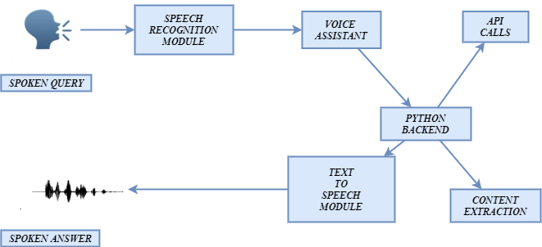

02
Proposed
System
2.2 Proposed System Diagram

Slide 11
SMS
@

Slide 12

Tasks including opening apps, changing the volume, and organizing files that are associated with managing the computer's settings and operations.
System Control
Information
Retrieval
Tasks such online searches, weather updates, and query responding that involve getting data from a local system or the internet.
Communication
Tasks involving communication, such setting up meetings, making calls, and sending emails.
Entertainment
Tasks involving communication, such setting up meetings, making calls, and sending emails.
Productivity
Functions related to productivity such as setting reminders, managing tasks, and providing news updates.
2.3 List Of Modules
and Explanation

Slide 13
01
Introduction
02
Proposed
System
03
Implementation
And
Results
04
Conclusion
And
Future Work
CONTENTS

Slide 14
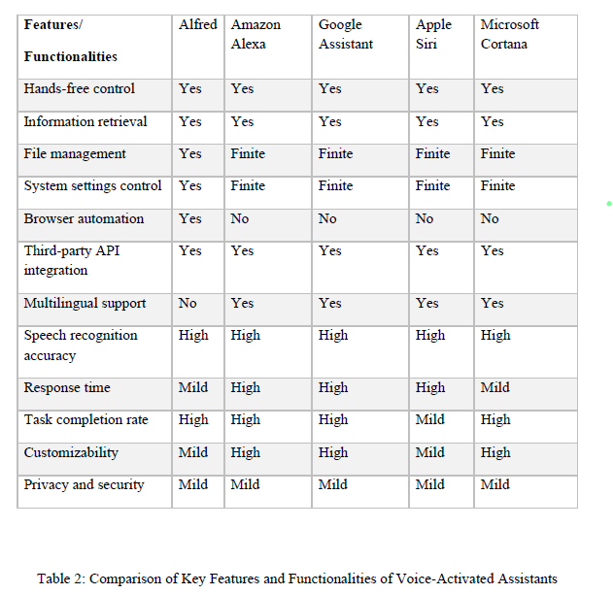
03
Implementation
And
Results
3.1 Table: Comparison of Key Features and Functionalities of Voice-Activated Assistants

Slide 15
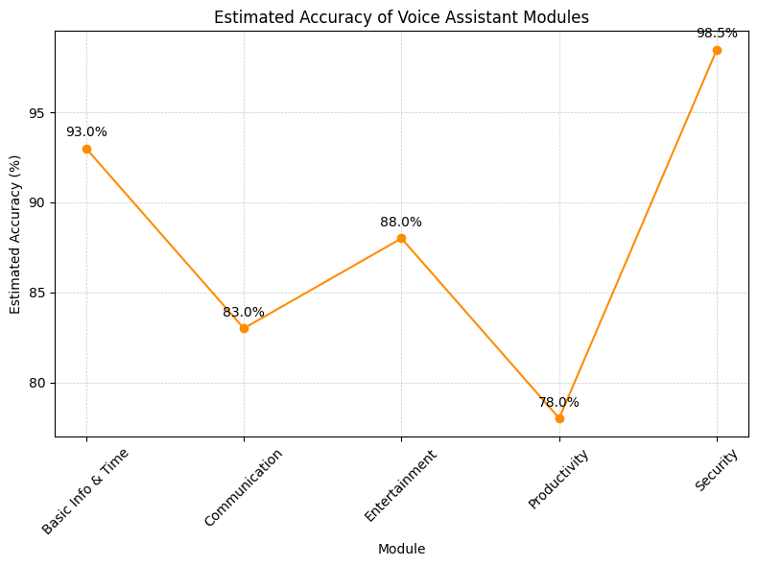
03
Implementation
And
Results
3.2 Estimated Accuracy of Voice Assistant Modules

Slide 16
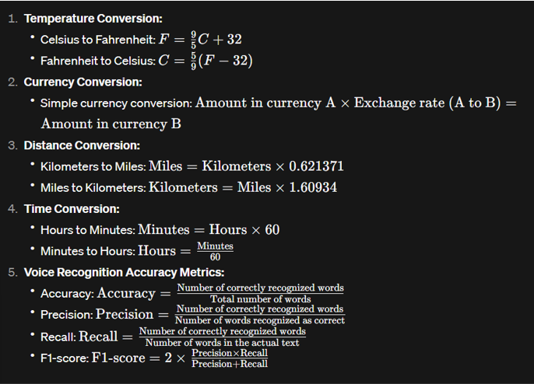
03
Implementation
And
Results
3.3 Equations

Slide 17
High Accuracy
Increased Functionality
User requests are processed successfully and with few mistakes thanks to precise text-to-speech and speech recognition software.
Simple integration and scalability with other apps lead to improved capabilities.
Improved User
Experience
Secure System
Increased efficiency and naturalness of engagement with the system, which shortens work completion times.
Protection of user information and privacy through the deployment of security measures; no breaches or illegal access attempts have been detected.
2
3
1
3.4 Results
4

Slide 18
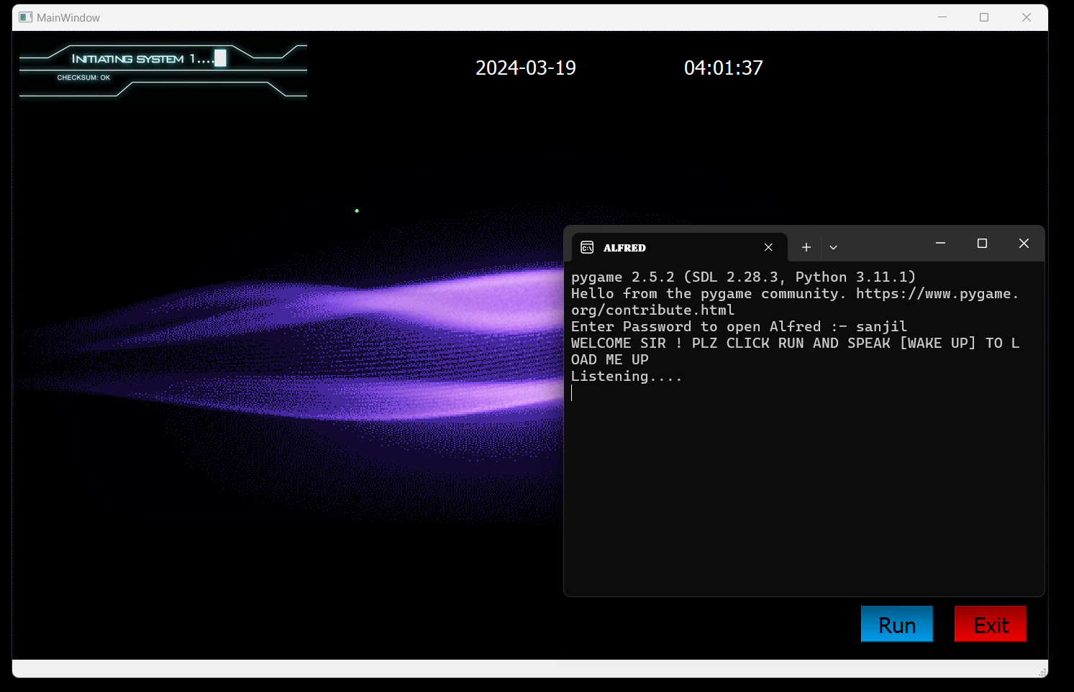
03
Implementation
And
Results
3.5 User Interface of Alfred

Slide 19
03
The system's exceptional precision in handling user inquiries resulted in higher job completion rates.
01
The many capabilities may be seamlessly integrated because to Alfred's modular architecture.
04
User privacy and data were protected thanks to the security measures put in place.
02
The text-to-speech and speech recognition modules made it possible to communicate with the system effectively and hands-free.
3.6 Findings

Slide 20
01
Introduction
02
Proposed
System
03
Implementation
And
Results
04
Conclusion
And
Future Work
CONTENTS

Slide 21
By delivering a more seamless and effective user experience, the voice assistant system decreased job completion times and increased overall productivity.
The development and deployment of voice assistant systems depend heavily on the safety of user data and privacy, which was made possible by the deployment of security measures.
The system's modular architecture made it simple to scale and integrate with other apps, which enhanced its utility and potential.
4.1 Conclusion
The results of this project demonstrate the potential of voice assistant systems in various applications, and future work could focus on improving the accuracy and functionality of the system, as well as exploring new use cases and integration with emerging technologies.
With few mistakes and misinterpretations, user requests were successfully processed thanks to the excellent accuracy of the text-to-speech and speech recognition modules.

Slide 22

Improving Accuracy
01
Expanding Functionality
Improve accuracy in speech recognition and text-to-speech modules.
02
NLP Understanding
Expand functionality by integrating with new services and devices.
User Personalization
4.2 Future Work
03
Incorporate natural language processing for better understanding of complex requests.
Personalize the system to individual users for improved user experience.
04

Slide 23
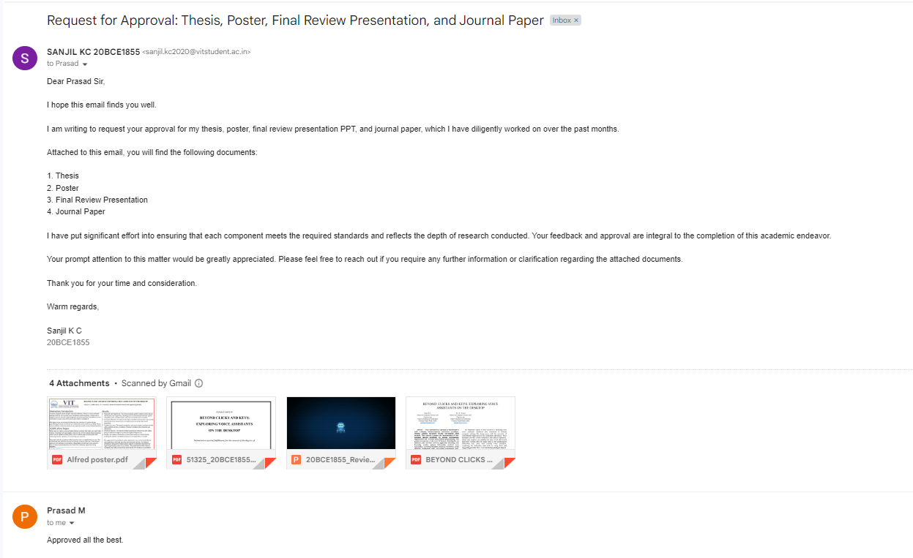
Guide Approval Mail
Snapshot

Slide 24
Research Paper Status
I have completed my paper and submitted it to the Computer Science Review journal. It is currently undergoing the review process.
Journal Information:
Title: Computer Science Review
Scopus coverage years: from 2007 to Present
Publisher: Elsevier
ISSN: 1574-0137
Subject area:
Computer Science: General Computer Science
Mathematics: Theoretical Computer Science
Source type: Journal

Slide 25
References
V. Appalaraju, V. Rajesh, K. Saikumar, P. Sabitha and K. R. Kiran, "Design and Development of Intelligent Voice Personal Assistant using Python," 2021 3rd International Conference on Advances in Computing, Communication Control and Networking (ICAC3N), Greater Noida, India, 2021, pp. 1650-1654, doi: 10.1109/ICAC3N53548.2021.9725753.
S. D. Vara Prasad, J. Kavitha, G. C. Babu, K. V. M. Mohan and P. G. Krishna, "An Advanced Computerized Artificial Intelligent System for Assisting Real Life Feature Extraction using AI-NOVA," 2023 5th International Conference on Smart Systems and Inventive Technology (ICSSIT), Tirunelveli, India, 2023, pp. 1337-1342, doi: 10.1109/ICSSIT55814.2023.10061087.
T. M. N. Vamsi, B. Suchitra, S. Kumar, K. V. V. Varma and K. N. S. H. Kumar, "An IoT based Smart Home with Virtual Assistant," 2021 6th International Conference for Convergence in Technology (I2CT), Maharashtra, India, 2021, pp. 1-4, doi: 10.1109/I2CT51068.2021.9417883.
M. S. Devi, N. S N, M. Nirmala, V. A and Y. G. K K, "LARVIS - Linux AIRelied Virtual Intelligent System," 2023 Eighth International Conference on Science Technology Engineering and Mathematics (ICONSTEM), Chennai, India, 2023, pp. 1-7, doi: 10.1109/ICONSTEM56934.2023.10142584.
A. Jagan, M. Ghouse Pasha, D. Nandini, H. Susanna and D. N. Parvathi, "Personal Voice Assistant Using Computer Vision," 2023 International Conference on Research Methodologies in Knowledge Management, Artificial Intelligence and Telecommunication Engineering (RMKMATE), Chennai, India, 2023, pp. 1-8, doi: 10.1109/RMKMATE59243.2023.10369477.

Slide 26
References
P. Kunekar, A. Deshmukh, S. Gajalwad, A. Bichare, K. Gunjal and S. Hingade, "AI-based Desktop Voice Assistant," 2023 5th Biennial International Conference on Nascent Technologies in Engineering (ICNTE), Navi Mumbai, India, 2023, pp. 1-4, doi: 10.1109/ICNTE56631.2023.10146699.
S. P. Yadav, A. Gupta, C. Dos Santos Nascimento, V. Hugo C. de Albuquerque, M. S. Naruka and S. Singh Chauhan, "Voice-Based Virtual-Controlled Intelligent Personal Assistants," 2023 International Conference on Computational Intelligence, Communication Technology and Networking (CICTN), Ghaziabad, India, 2023, pp. 563-568, doi: 10.1109/CICTN57981.2023.10141447.
R. Aldhafiri, G. Powell, E. Smith and C. Perera, "Voice-Enabled Privacy Assistant Towards Facilitating Successful Ageing in Smart Homes," 2023 IEEE International Conference on Pervasive Computing and Communications Workshops and other Affiliated Events (PerCom Workshops), Atlanta, GA, USA, 2023, pp. 343-345, doi: 10.1109/PerComWorkshops56833.2023.10150259.
P. N. Singh, N. M. and P. V. Tijare, "Operating System Command Execution Using Voice Command," 2023 3rd Asian Conference on Innovation in Technology (ASIANCON), Ravet IN, India, 2023, pp. 1-5, doi: 10.1109/ASIANCON58793.2023.10269894.
P. Dalal, T. Sharma, Y. Garg, P. Gambhir and Y. Khandelwal, "“JARVIS” - AI Voice Assistant," 2023 1st International Conference on Innovations in High Speed Communication and Signal Processing (IHCSP), BHOPAL, India, 2023, pp. 273-280, doi: 10.1109/IHCSP56702.2023.10127134.

Slide 27
References
D. K. Yadlapally, B. Vasireddy, M. Marimganti, T. Chowdary, C. Karthikeyan and T. Vignesh, "A Review on the Potential of AI Voice Assistants for Personalized and Adaptive Learning in Education," 2023 7th International Conference on Computing Methodologies and Communication (ICCMC), Erode, India, 2023, pp. 422-427, doi: 10.1109/ICCMC56507.2023.10084208.
B. Savić, M. Milić and S. Vlajić, "Analysis and Development of the Model for Google Assistant and Amazon Alexa Voice Assistants Integration," 2023 27th International Conference on Information Technology (IT), Zabljak, Montenegro, 2023, pp. 1-4, doi: 10.1109/IT57431.2023.10078705.
S. Chauhan and D. Arora, "Development of Cloud based Smart Voice Assistant using Amazon Web Services," 2023 2nd International Conference on Applied Artificial Intelligence and Computing (ICAAIC), Salem, India, 2023, pp. 1217-1221, doi: 10.1109/ICAAIC56838.2023.10140284.
D. Lahiri, P. C. P. Kandimalla and A. Jeysekar, "Hybrid Multi Purpose Voice Assistant," 2023 2nd International Conference on Applied Artificial Intelligence and Computing (ICAAIC), Salem, India, 2023, pp. 816-822, doi: 10.1109/ICAAIC56838.2023.10140365.
.Y. Lee, N. Kim, J. Jeong and I. -Y. Kwak, "Experimental Case Study of Self-Supervised Learning for Voice Spoofing Detection," in IEEE Access, vol. 11, pp. 24216-24226, 2023, doi: 10.1109/ACCESS.2023.3254880.

Slide 28
References
Abhay Dekate, Chaitanya Kulkarni, Rohan Killedar, "Project of Voice Controlled Personal Assistant Device", International Journal of Computer Trends and Technology (IJCTT) - Volume 42 Number 1 December 2016.
Deny Nancy, Sumithra Praveen, Anushria Sai, M.Ganga, R.S.Abisree, "Voice Assistant Application for a college Website", International Journal of Recent Technology and Engineering (IJRTE) ISSN: 2277-3878, Volume-7,April 2019.
Deepak Shende, Ria Umahiya, Monika Raghorte, Aishwarya Bhisikar, Anup Bhange, "Al Based Voice Assistant Using Python", Journal of Emerging Technologies and Innovative Project (JETIR), February 2019, Volume 6.
Dr.Kshama V.Kulhalli, Dr.Kotrappa Sirbi, Mr.Abhijit J. Patankar, "Personal Assistant with Voice Recognition Intelligence", International Journal of Engineering Project and Technology. ISSN 0974-3154 Volume 10, Number 1 (2017).
Y. Lee, N. Kim, J. Jeong and I. -Y. Kwak, "Experimental Case Study of Self-Supervised Le. Isha S. Dubey, Jyotsna S. Verma, Ms.Arundhati Mehendale, "An Assistive System for Visually Impaired using Raspberry Pi", International Journal of Engineering Project & Technology (IJERT), Volume 8, May-2019.arning for Voice Spoofing Detection," in IEEE Access, vol. 11, pp. 24216-24226, 2023, doi: 10.1109/ACCESS.2023.3254880.

Slide 29







Thank you for listening
I wish you have a nice day.
TEL : EMAIL : sanjilkc0@gmail.COM

